Slide 1
HISTORY OF AGRICULTURE
Linda Mezzalira 3°A

Slide 2
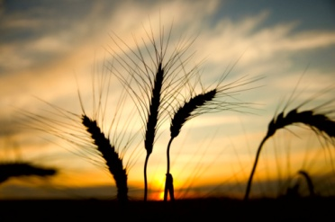
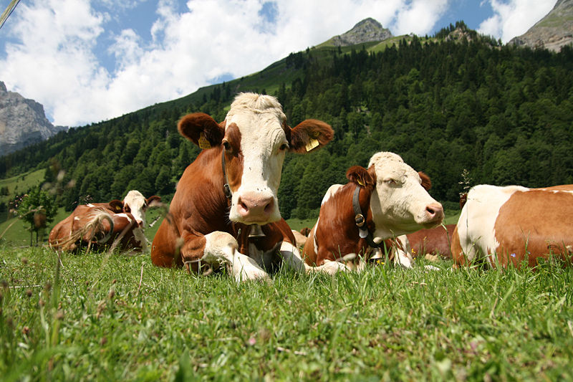
Definition
Agriculture is the science and activity of growing plants and raising animals for human use.

Slide 3
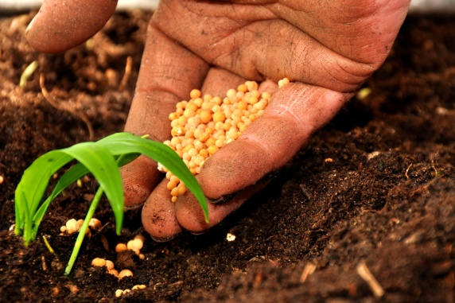
Basic Steps
The basic steps are:
Tilling: preparing land for growing plants.
Planting: putting seeds and plants in the ground to grow.
Harvesting: gathering crops.
Raising livestock: breeding farm animals.
Marketing: practice of commercial selling.
Packing: putting products into a box or other container so that they can be moved, stored or sold.
Processing: preserving food in order to make it ready to be used.

Slide 4
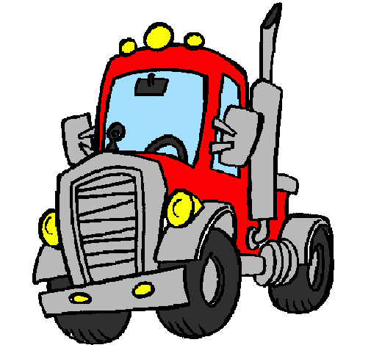
Modern Agriculture
Modern Agriculture depends on engineering, technology, biological and physical sciences.
Mechanization has caused the decline of labour force but has reduced the cost and increased the variety of food available.
Another factor of modern agriculture is chemistry, which deals with selective breeding techniques, fertilizers, herbicides, pesticides and fungicides.

Slide 5
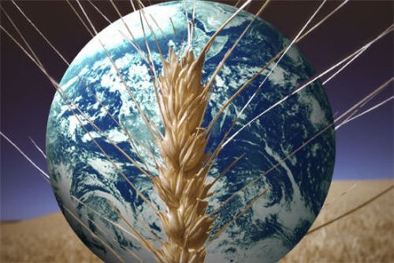
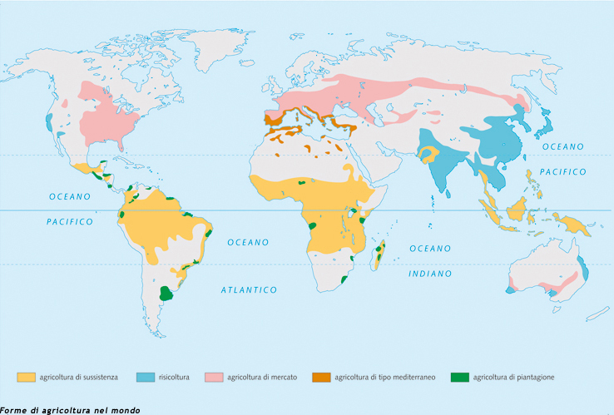
World Agriculture
Agriculture is the world’s largest economic sector.
Mondial labour force: 50%
Africa: 64%
Asia: 61%
North America: 4%
South America: 24%
East Europe: 15%
Western Europe: 7%

Slide 6
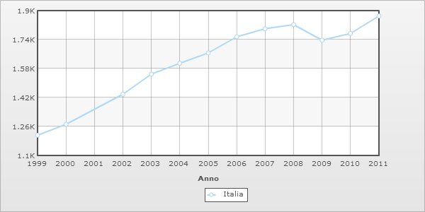
Agriculture in Italy
In Italy the most important products are: wine, corn, oil, tomatoes, milk of cow and buffalo.
GDP: $1.822 trillion (2011)

Slide 7
GDP Italian Regions
GDP 2009
REGION TOTAL GDP (mln €)
Piemonte: 108.405 €
Valle d'Aosta: 3.716 €
Liguria: 39.462 €
Lombardia: 286.983 €
Trentino-Alto Adige: 30.601 €
Veneto: 128.802 €
Friuli-Venezia Giulia: 31.371 €
Emilia-Romagna: 121.892 €
Marche: 36.241 €
Toscana: 93.133 €
Umbria: 18.932 €
Lazio: 150.355 €
Abruzzo: 25.343 €
Molise: 5.920 €
Marche: 36.241 €
Toscana: 93.133 €
Umbria: 18.932 €
Lazio: 150.355 €
Abruzzo: 25.343 €
Molise: 5.920 €
Campania: 85.948 €
Puglia: 61.875 €
Basilicata: 9.729 €
Calabria: 29.934 €
Sicilia: 75.804 €
Sardegna: 29.422 €
Italy: 1.376.034 €

Slide 8
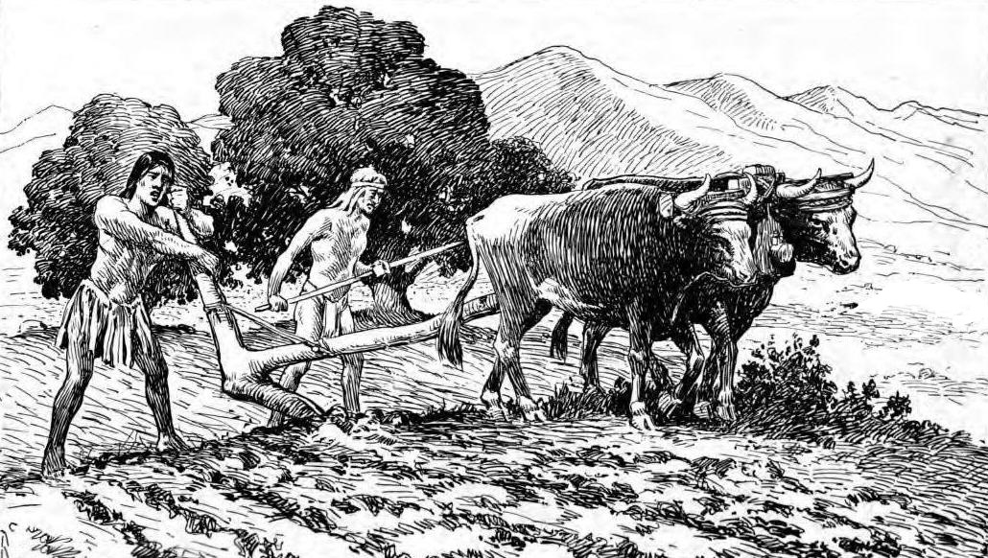
Agriculture Development
From the origin of human society, life has been greatly influenced by food. The ancient tribal societies were based on hunting and gathering.
Prehistoric agriculture developed mainly in the areas of the Middle East, Asia , Africa and in Europe.
The most important crops were cereals, such as: corn, rice, barley, wheat, rye, sugarcane and sugar beets.
Cereals are important
because they are the basis
of human diet.

Slide 9
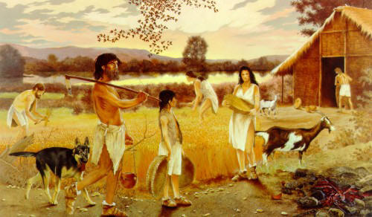
History
The origin of agriculture pre-dates the invention of writing. Agriculture started more than 10,000 years ago. Transition from hunting animals and gathering crops to raising livestock and growing plants was very important for mankind.
The history of agriculture may be divided into four periods:
Prehistoric
Historic period 1 , 2
Feudal 1, 2
Scientific 1, 2

Slide 10
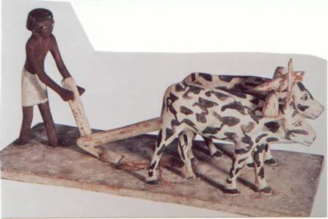
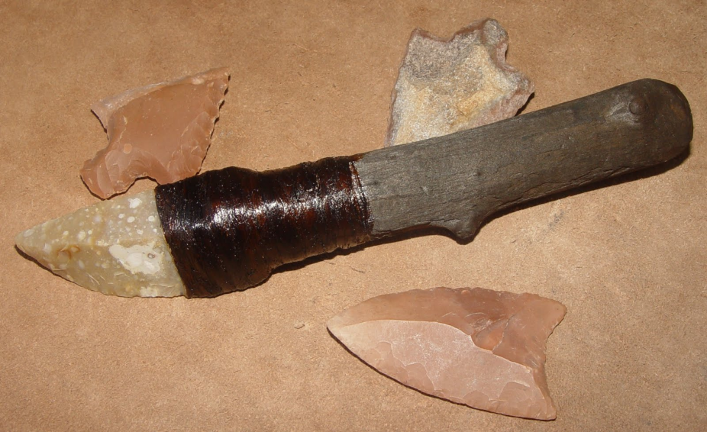
Prehistoric Period
The practice of agriculture started in the Neolithic Period. Sites occupied were: Asia, Africa and Europe.
Neolithic farmers lived in caves and in small houses of mud or wood. The villages were surrounded by fields.
Neolithic agriculture was mixed. The first tools were: adz used to gather grain, digging stick used to plant seeds, and rudimentary plough, a tree branch used to scratch soil.

Slide 11
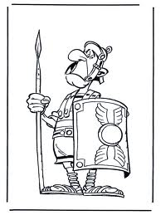
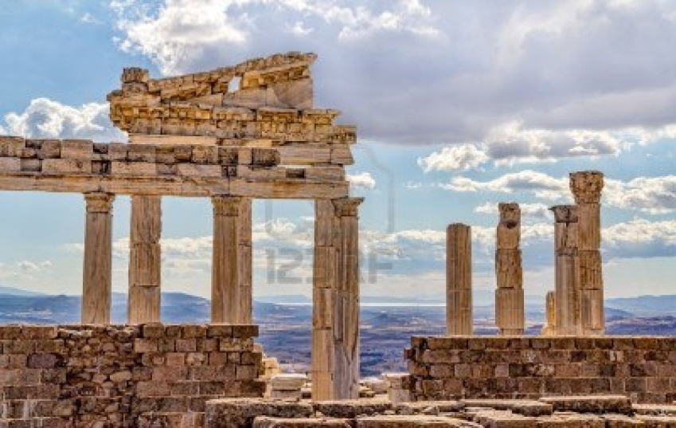
Historic Period 1
The Roman Period goes from 2,500 BC to 500 AD.
Grapes and olives were cultivated in the first
millennium BC
In the second millennium BC horses and oxen were used for work.
Metal tools were introduted because they were more efficient and longer lasting.
Storage methods for oil and grain
were improved (granaries, jars,
silos…).
Introduction of: irrigation system,
wind and water mills, fertilizers
and crop rotation.

Slide 12
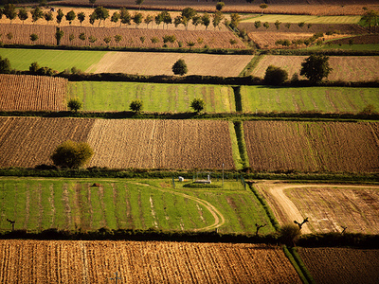
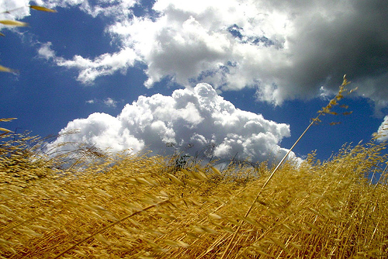
Historic Period 2
Rome started as a rural agricultural society of indipendent farmers.
The Roman agricultural system was organized in large estates that were owned by absentee land owners who were in war.
The large estates were cultivated by slaves under the supervision of hired overseers.

Slide 13
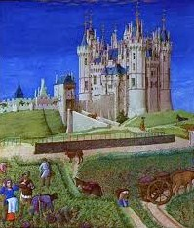
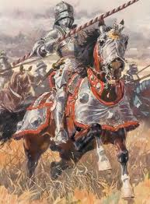
Feudal Period 1
The Feudal period goes from 500 AD to 1,500 AD after the fall of the Roman Empire (476 AD).
Innovations in farming:
New types of ploughs allowed for easier plantation.
The method of crop rotation began at this
time as well. The land was divided into
three fields.
Ten or more oxen were fastened to the
tongue of the plough.

Slide 14
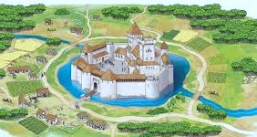
Feudal Period 2
The manor was the centre of feudal life and it was a self-contained community. There was the large home of the lord and peasants produced their crops, raised animals and paid taxes in services. In a manorial system there were:
A mill to grinding grain;
An oven for baking bread;
Fishponds, orchards;
A wine or oil press;
Herb and vegetable gardens.
Feudalism ended with the wars of 14° and 15° century and plague outbreaks; villages were destroyed and land was abandoned.

Slide 15
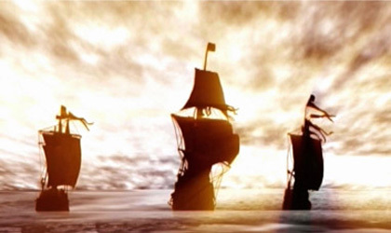
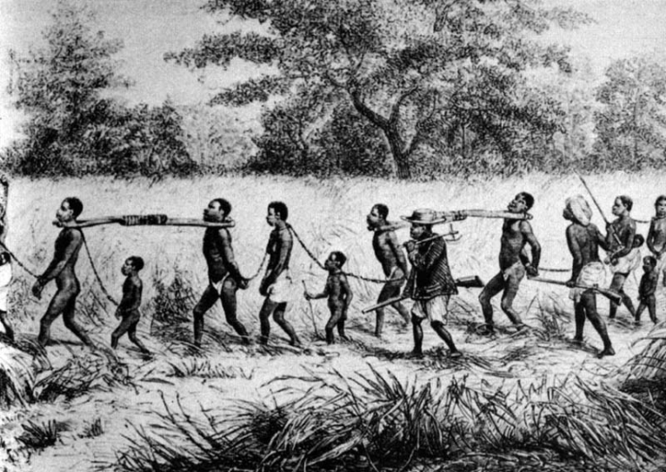
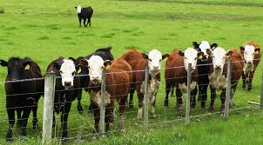
Scientific Period 1
Tha Scientific period goes from 16° century to the 20° century.
In this period:
Population and agriculture were
increasing in Europe;
Exploration and colonization started
(colonial agriculture);
Slaves from Africa worked on
cotton plantations in America;
Scientific revolution (new
cultivation and types of cattle and
sheep);

Slide 16
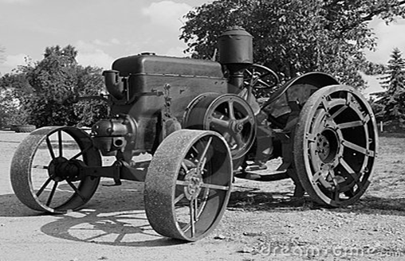
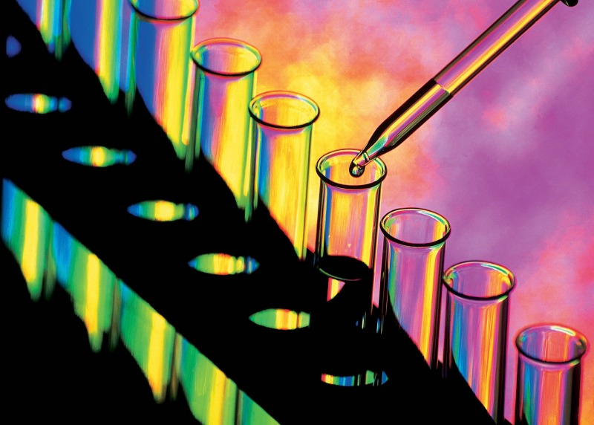
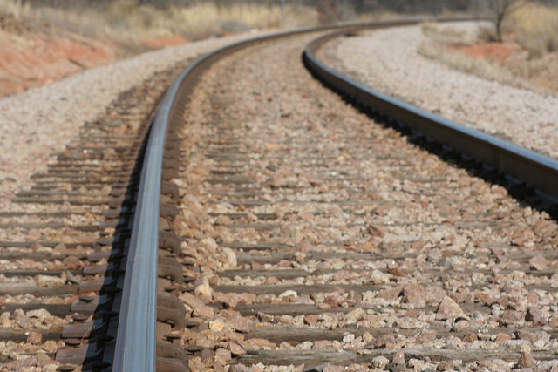
Scientific period 2
Dranaige (more land cultivated);
Farm machinery (John Deere);
Steam power was used to replace
animal power;
Pests (sprays, poisons);
Improvements in trasportation (roads, canal, rail lines…)

